Slide 1
IOT LAB

Slide 2
Lab 7
Microcontroller Experiments using Arduino or MSP430: Display and I/O interfacing
LED flash light
7-segmented display

Slide 3
LED
int LEDpin = 13;
int delayT = 1000;
void setup() {
// put your setup code here, to run once:
pinMode(LEDpin, OUTPUT);
}
void loop() {
// put your main code here, to run repeatedly:
digitalWrite(LEDpin, HIGH);
delay(delayT);
digitalWrite(LEDpin, LOW);
delay(delayT);
}

Slide 4
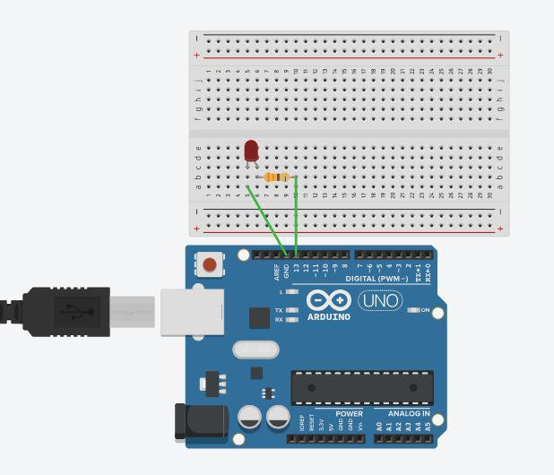
LED

Slide 5
7 Segment Display
The seven-segment displays are designed for displaying numeric values.
They are the most practical way to display numeric values.
They are cheap and easy to use.
Not only that, they are highly readable in any light condition, unlike LCDs.

Slide 6
7 segment Display
And here is a small simulation showing the Seven Segment Interface.
The Arduino will count from 0 to 9 and repeat. The value will be displayed on the Seven Segment display.
Seven-segment displays are available in various sizes and colours.
They are available from 0.28 inches to 18 inches, and even bigger sizes are available for industrial usage.
The most commonly used display size is 0.56 inches.

Slide 7
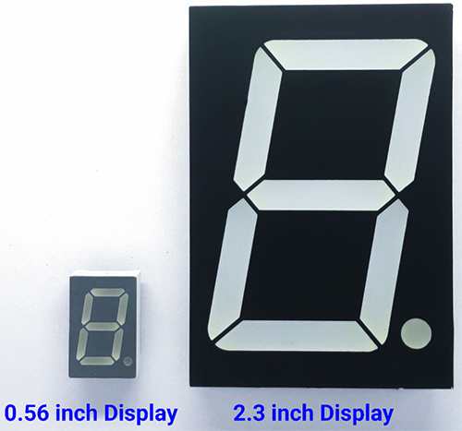
7 segment Display

Slide 8
7 segment Display
As the name suggests, the seven-segment display consists of seven LEDs, which are arranged in a particular order to form the digit eight.
And most common modules will come with an additional LED to indicate the decimal point.
This will be useful when using multiple display modules to display a decimal number.
Each one of these LEDs are arranged in a specific order as a segment and one of its pins is being brought out of the plastic package.
The other LED pins are connected together and wired to form a common pin.

Slide 9
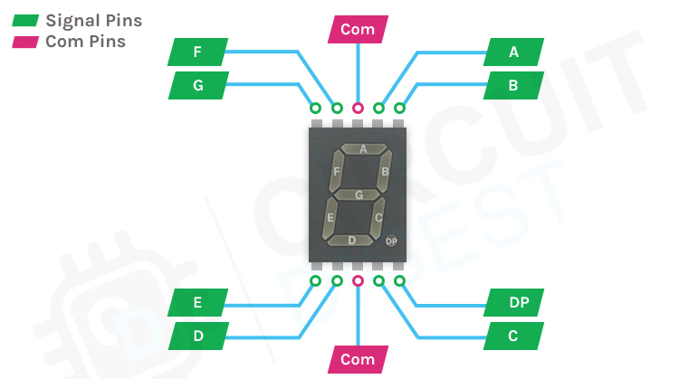
7 Segment Display

Slide 10
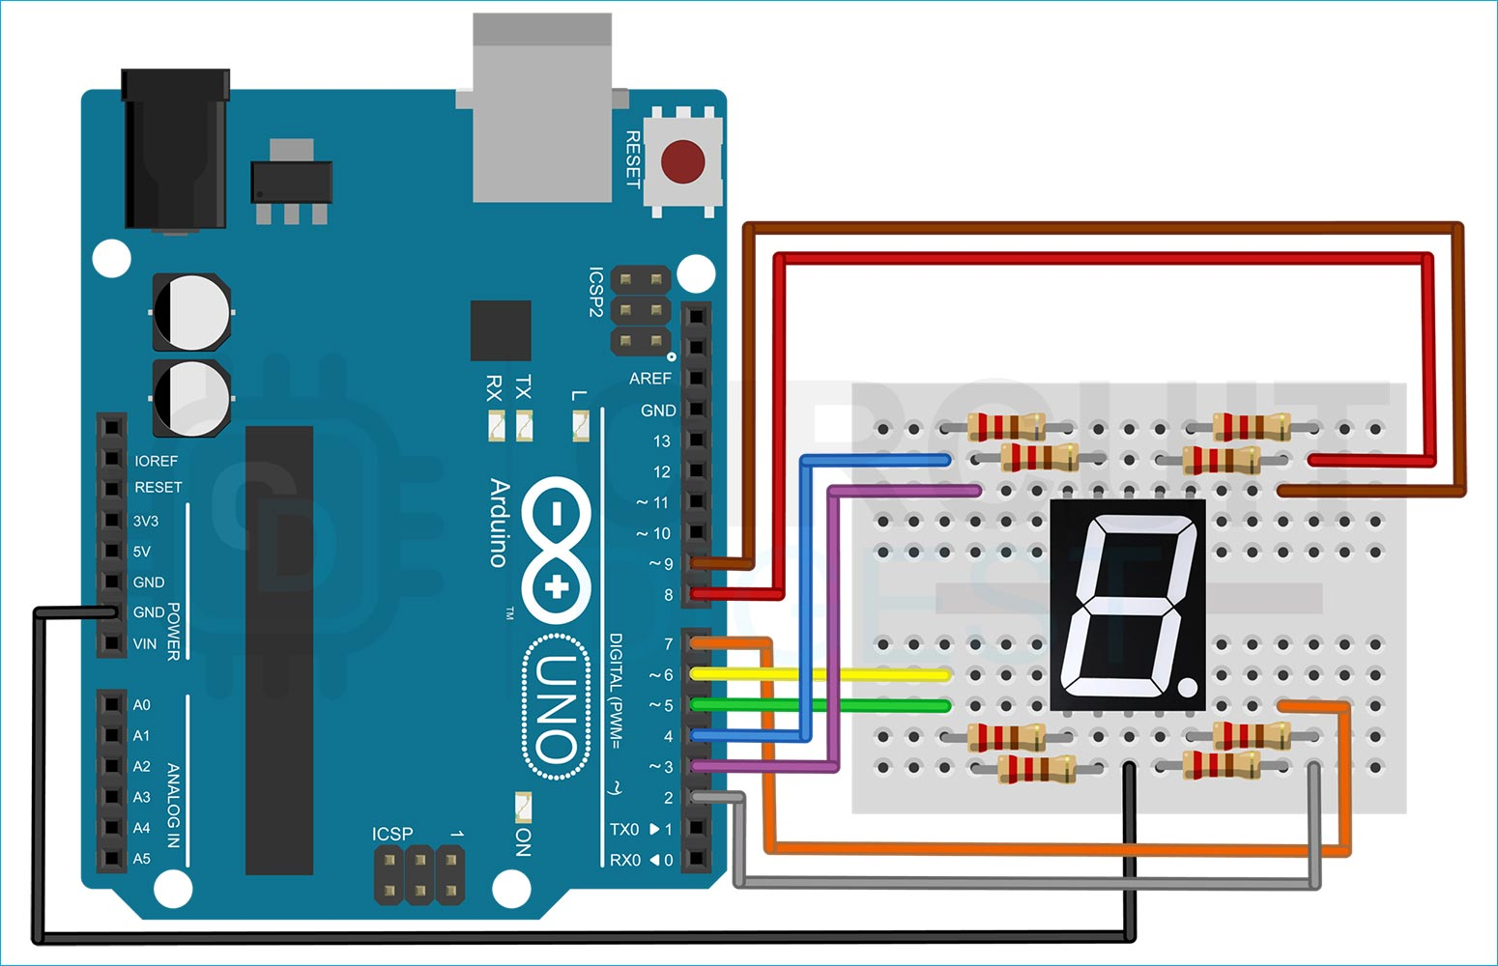
7 segment display

Slide 11
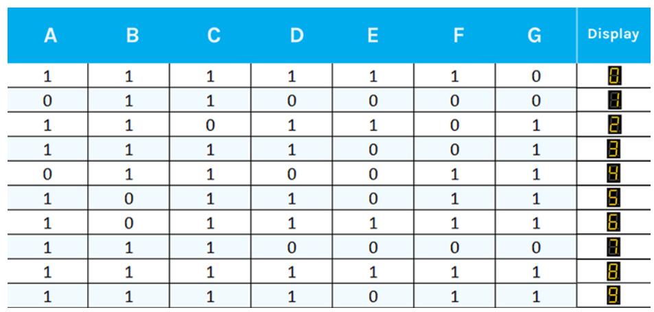
7 Segment Display

Slide 12
7 Segment Display
Seven segment displays are mainly categorized into two types, Common Cathode (CC) and Common Anode (CA).
This classification is done based on which pin of the LEDs is connected to the common pin.
If the Anodes of these LEDs are connected together, then it’s called Common Anode displays.
And if the Cathode is connected together, then they are called Common Cathode displays.

Slide 13
7 Segment Display
Common Cathode Displays
In a Common Cathode (CC) display, all the cathodes of the LEDs are connected together to the common pin.
This common pin is then connected to the ground rail of the circuit.
The individual LEDs can be activated by applying a high pulse or a logic 1 signal to the corresponding pin.

Slide 14
7 Segment Display - Common Cathode Displays

Slide 15
7 Segment Display
Common Anode Displays
In a Common Anode (CA) display, all the anodes of the LEDs are connected together to the common pin.
This common pin is then connected to the positive rail of the circuit.
The individual LEDs can be activated by applying a low pulse or a logic 0 signal to the corresponding pin.

Slide 16
7 Segment Display - Common Anode Displays

Slide 17
#include "SevSeg.h"
SevSeg sevseg;
void setup() {
byte numDigits = 1;
byte digitPins[] = {};
byte segmentPins[] = {9,8, 7, 6, 5, 4, 3, 2};
byte displayType = COMMON_CATHODE;
bool resistorsOnSegments = true;
sevseg.begin(displayType, numDigits, digitPins, segmentPins, resistorsOnSegments); sevseg.setBrightness(90);
}

Slide 18
void loop() {
for(int i = 0; i <= 10; i++)
{
if (i == 10) { i = 0; }
sevseg.setNumber(i);
sevseg.refreshDisplay();
delay(1000);
}
}

